Slide 1
Introduction to Linux
By Björn Claremar
Based on work by Marcus Lundberg & Lars Eklund
What is Linux
Logging in to UPPMAX
Navigate the file system
“Basic toolkit”

Slide 2

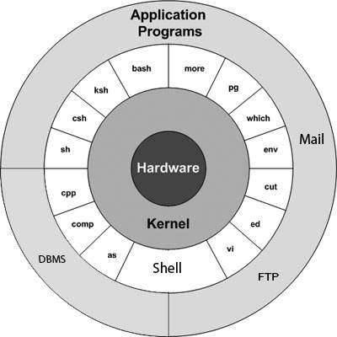
What is Linux
The Linux Operating system is a UNIX like UNIX compatible Operating system.
Linux is a Kernel on which many different programs can run. The shell(bash, sh, ksh, csh, tcsh and many more) is one such program
Actually, for it to be an OS, it is supplied with GNU software and other additions giving us the name GNU/Linux
Linux has a multiuser platform at its base which means permissions and security comes easy.
Notes:
I was created separately from the GNU initiative by Linus Torvalds to generate a free operating system that was compatible with Unix in 1991.
Linux is:
– an operating system
– made of many composable small (and large) bits and pieces
– a multi-user environment
● Easy to share, easy to care, easy to dare
– the industry standard
– reliant on the command line

Slide 3








Many Flavours
Notes:
Many many Flavours exist with slightly different but essentially all the scripts and programs will work on any of them We use CentOS at UPPMAX

Slide 4
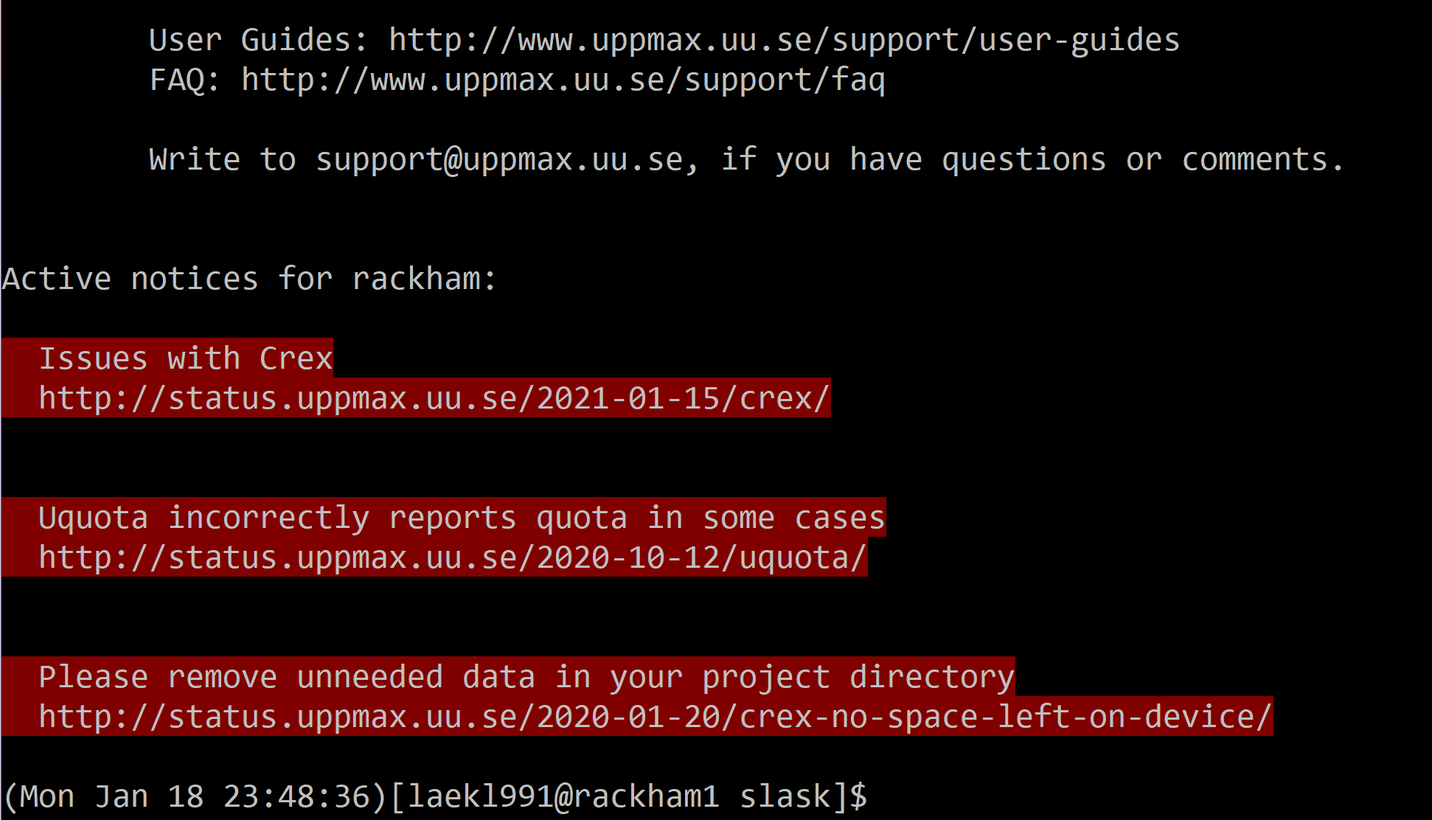
Connect to UPPMAX
(Download XQuartz or other X11 server for Mac OS )
Linux and MacOS:
– start Terminal
– $ ssh -X username@rackham.uppmax.uu.se
Notes:
Is everyone connected?
● Take time now to connect
● Consider connecting a second time with a new
window
● Organise your windows so you can watch Zoom and
work in your terminal. If you have screen space,
keep the presentation open locally and an eye on
the Zoom chat.
I assume you have done this already at least once before the main lectures started but if there are any problems dont hesitate to ask in chat some one will help you with your problem.

Slide 5
Connect to UPPMAX for windows users
Download a X-server such as GWSL or X-ming or VcXsrv or an other of your choosing
Install WSL and a Distribution such as ubuntu or a ssh program such as MobaXTerm
Connect to $ ssh -X username@rackham.uppmax.uu.se

Slide 6
Windows links
https://sourceforge.net/projects/vcxsrv/
https://mobaxterm.mobatek.net/
https://opticos.github.io/gwsl/
https://sourceforge.net/projects/xming/
https://docs.microsoft.com/en-us/windows/wsl/install-win10
Don’t forget to update to wsl2

Slide 7
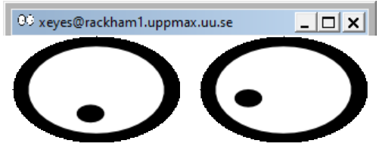
X11-forwarding graphics from the command line
Graphics can be sent through the SSH connection you’re using to connect
Use ssh -Y or ssh -X
MacOS users will need to install XQuartz.
When starting a graphical program, a new window will open, but your terminal will be “locked”.
Run using & at the end to run it as a background proccess e.g. “gedit &”
Alternatively, use ctrl-z to put gedit to sleep and type bg %1 to make process number one run in background

Slide 8

Command line with bash
● The command-line interface: the bash prompt $
● bash is a program that finds and runs other programs
● bash is scripting language that is referred to as a shell
(because it sits around the kernel making it easy to interact with)

Slide 9
The prompt
[info]$ program word1 word2 word3 […]
● [info] is configurable, and usually tells you who
you are, on what system, and where in the file system
● The program to run is the first word
● All words are separated by spaces

Slide 10

Program, flags, and files
● Input:
Flags: specific single letters or words. that change the behaviour of a program.
Arguments: text given to the program when started, e.g. file names.
Terminal input: text given to the program while it runs.
● Output:
Most Linux programs output to the terminal.
Some also write to files.
Notes:
-Flags e.g. ‘-i’ to ignore case or ‘-n 10’ to set a number to 10

Slide 11
Example bash command
$
mv
-v
inbox/*
outbox/
Program
Flags
‘inbox/data1.dat’ -> ‘outbox/data1.dat’
‘inbox/data2.dat’ -> ‘outbox/data2.dat’
‘inbox/data3.dat’ -> ‘outbox/data3.dat’
Argument 1
Argument 2
Output
Notes:
Question: How does Bash know what is what on the command line?

Slide 12

Tab Completion
Whenever you’re writing a path or filename on the bash prompt, you can strike the ‘tab’ key to ask Bash to complete what you’re writing
Get in the habit of this — it will save you many hours

Slide 13

Editing files
● File/text editors :
nano (keyboard shortcuts shown on-screen)
gedit (graphical, needs X11)
vim (fast and powerful, once you learn it)
gvim vim with a GUI, lots of features very Fast
emacs (fast and powerful, once you learn it)
With GUI
$ emacs –nw keeps you in terminal window.
● Try them out and pick one.

Slide 14

Typical sources of error
Capitalisation matters in file names and
program names
Spaces matter. Always have a space after the program name. Don’t add spaces in file names.
Check that you are in the right place in the file system.
File permissions. Check that the rigth read,write and execute permission are set

Slide 15

Caution!!
Some words of warning:
There is no undo for cp, mv, and rm.
Beware of overwriting (clobbering) files and deleting the wrong ones.
Tip
alias rm=‘rm -i’
This asks you if your are sure
Override with “rm –f <>”
If you do destroy your data, email UPPMAX support, we may be able to help

Slide 16
Thank You for Your attention
NOW STARTS THE CODE ALONG
Remember: Capitalisation matters and so do SPACES “ “
and there are NO do-overs
Therefore it is good practices to work on copies of your data and keep your data write protected which we will teach you how to do

Slide 17
We will cover these commands
Navigation and file management
pwd present directory
ls list content
cd change directory
mkdir make directory
cp copy
scp remotely copy
mv move
rm remove
rmdir remove empty directory
Read files and change file properties
cat print content on screen
head print first part
tail print last part
less browse content
tar compress or extract file
chmod change file permissions
man info about a command

Slide 18
File system Navigation
pwd — where are you now? “Print name of current/Working Directory”
$ pwd
$ pwd -P gives you the physical path
(ignores how you got there)

Slide 19
File system Navigation
ls —list directory contents
Type ls to display the contents of the current directory.
$ ls -a also shows hidden files and directories
$ ls -l gives you detailed information
$ ls -lt sorts things by time modified
$ ls –lrt reversed order
$ man ls for complete information
TIP
$ man <command> works for any command!

Slide 20
File system Navigation
cd — moving around
To change directory, use cd <target>
$ cd /proj/introtouppmax
$ pwd
$ ls
$ cd labs
$ pwd

Slide 21
File system Navigation
cd
Experiment with cd. Try adding spaces or extra / in various places
Use tab completion to avoid typos and typing “ls” a lot.
Figure out the use of the following:
$ cd -
$ cd ..
$ cd
$ cd ~

Slide 22
Copy, Create, Move
mkdir — create a new directory
Make sure you’re in your home directory ($ cd ~)
$ mkdir uppmax-intro
● Go in there:
$ cd uppmax-intro/

Slide 23
Copy, Create, Move
cp — copy files
Copy files with: cp <source> <target>
$ cp /proj/introtouppmax/labs/linux_tutorial/ .
Well, that didn’t work. What does the error say?
$ cp -r /proj/introtouppmax/labs/linux_tutorial/ .
-r is for recursive, meaning including files and subdirectories!

Slide 24
Copy, Create, Move
cp — copy files
Move to linux_tutorial/
Make a copy of the file “newfile” in the same directory: - $ cp newfile copyfile

Slide 25
Copy, Create, Move
scp —secure copy (remote file copy program)
Linux/MacOS: To copy data to/from Rackham, you can use scp from your local machine:
Upload
[bob@macbook]$ scp myinput bob@rackham.uppmax.uu.se:~/copyofmyinput
[bob@macbook]$ scp myinput bob@rackham.uppmax.uu.se:~/ (keeping filename)
Download
[bob@macbook]$ scp bob@rackham.uppmax.uu.se:~/mydata copyofmydata
[bob@macbook]$ scp bob@rackham.uppmax.uu.se:~/mydata . (keeping file name)

Slide 26
Copy, Create, Move
mv — move/rename file
Moving files works just like copying files: mv <source> <target>
Move the copy you just made to another place:
$ mv copyfile ../
Rename it.
$ mv ../copyfile ../renamedfile

Slide 27
Deleting
rm — delete file
Deleting files works just like copying or moving them:
rm <target>
● Try it out:
$ rm ../renamedfile

Slide 28
Deleting
rmdir — delete an empty directory
$ rm this_is_empty
Need another command to delete directories
$ rmdir this_is_empty
$ rmdir this_has_a_file
Is there a way to use rm to delete directories?

Slide 29
Deleting
Recursive commands are applied to directories and their contents
$ rm -r this_has_a_file
Compare:
$ ls ..
$ ls -R ..

Slide 30
Compress, archive and extract
tar — archiving and compression
We’re going to need more files.
$ tar -vxzf files.tar.gz
The flags mean:
verbosely
extract
zipped
file
You should see a list of files being extracted

Slide 31
Help
man — look up the right flags
Nobody can remember whether it’s -R or -r for recursive, or if -f lets you choose a file or forces an action.
$ man ls shows you how to use ls and all its options
Type ‘/<keyword>’ to search for “<keyword>”, use ‘n’ and ‘N’ to scan through hits.
Type ‘q’ to quit.
Spend some time now to browse the man pages for the commands you’ve just learned

Slide 32

Let’s get wild with Wildcards
$ ls many_files
$ ls many_files/*.txt
$ ls many_files/file_1*1.docx
Want to clean out temporary files ending in .tmp in all the subdirectories?
$ rm */*.tmp (could be wise to do ls -a */*.tmp first to see what will be deleted...)
Exercise:
Create a new directory and move all .txt files in many_files to it

Slide 33
Reading files
In Linux, you can display files without being able to change them
$ cd old_project
$ ls
Hmm, which of these files are useful?

Slide 34

cat
cat dumps the contents of files to the terminal as text
$ cat the_best Yummy!
$ cat a ???
● Concatenate files with this wizardry:
$ cat a the_best > combinedfiles.txt

Slide 35
head — display the top of a file
$ head a
You can choose how many lines to display (default 10)
$ head -n 4 a
Tail is the same as head, but for the other end
$ tail -n 5 a
Handy to look at log files or to figure out the structure of a text file

Slide 36
less — read a whole file
cat doesn’t really work for long files
$ less a
Search with ‘/keyword’ and ‘n’/’N’
Hit ‘q’ to quit.
“less is more”

Slide 37

File permissions
ls -l
ex.drwxrwxr-x 2 marcusl marcusl 4096 Sep 19 2012 external_hdd or -rwxr-xr-x 1 marcusl marcusl 17198 Jul 16 14:12 files.tar.gz
Leading symbol:
d directory
- regular file
l symbolic link (more on this tomorrow)
Others exist, but you can ignore them for now

Slide 38
File permissions
$ ls -l
drwxrwxr-x 2 marcusl marcusl 4096 Sep 19 2012 external_hdd
-rwxr-xr-x 1 marcusl marcusl 17198 Jul 16 14:12 files.tar.gz
Three sets of “rwx” permissions
rwx: read, write, execute
User: the user account that owns the file (usually the one that created it)
Group: the group that owns the file (usually the project group in /proj/xyz or the user’s group elsewhere)
Others: everyone else on the system (literally a thousand strangers)

Slide 39
File permissions
r – read
Files: Read the contents of the file
Directories: List the files in the directory
w – write
Files: Modify the file
Directories: Add, rename, or delete files in the directory
x – execute
Files: Run the file as a program
Directories: Traverse the directory (e.g. with “cd”)

Slide 40
File permissions
$ ls -l /proj/introtouppmax/
Huh, rwxrwsr-x?
‘s’ in the group means ‘x’ but with gid bit set(group id of creator not launcher).
‘S’ means ‘-’ with gid bit set (rarely seen).
Among other things, this makes the default group for new files/subdirectories the g2020018 group.

Slide 41
Changing permissions
chmod — change file mode bits
Files with w can be modified and destroyed by accident. Protect your input data!
If you want to share data or scripts with a person not in your project (e.g. support staff like me), you can!
If you want to keep non-members from even seeing which files you have, you can!

Slide 42
Change file mode
chmod <mode> <files>
<mode> can be e.g.
u+x (let you run a script you just wrote)
-w (no write permissions for anyone)
g+rw (let group members read and edit this file)
g=xw (let group members go into your directory and put files there, but not see which files are there)
● chmod takes flags as usual, e.g. -R for recursive (i.e. all files and sub-directories therein)

Slide 43
chmod – numerical permissions
Online, you will come across e.g. “chmod 755”, what does this mean? It’s a “bit mask”:
7 = 4 + 2 + 1 = r + w + x
5 = 4 + 0 + 1 = r + x
Chmod — change file mode bits (man page)
What number would r + w be?

Slide 44
chmod — Hands-on
In the linux_tutorial directory, find important files and old saved data that you wouldn’t want to lose.
Directories: important_results/, old_project/
File: last_years_data
Use chmod to remove write permission from those files and directories (use the -R flag to also do the files in the directories).
Take a moment to play around with chmod and explore the effects of permissions on files and directories.

Slide 45
Summary BASH commands
Navigation and file management
pwd present directory
ls list content
cd change directory
mkdir make directory
cp copy
scp remotely copy
mv move
rm remove
rmdir remove empty directory
Read files and change file properties
cat print content on screen
head print first part
tail print last part
less browse content
tar compress or extract file
chmod change file permissions
man info about a command

Slide 46
Now try this
Review exercise:
Now try this:
- Create a new directory inside your home directory
- Cd into it
- Copy any file into the directory
- Rename the file to something else
- Delete the directory and its contents

Slide 47
Summarising exercises (1)
Find and delete the files named temp_file-1 and temp_file-2.
Can you do it with one command, standing in linux_tutorial/?
You may have to give yourself permission.

Slide 48
Summarising exercises (2)
Create a directory named “text_files”
Move all the .txt files in subdirectories of linux_tutorial into this directory
Use the “verbose” flag to get a report of which files were moved.

Slide 49
Summarising exercises (3)
Transfer files to and from Rackham. Use scp or FileZilla or MobaXterm or whatever you like.
Read up on the rsync tool for moving files.

